Slide 1
Micro Credit Defaulters
Shahbaz Alam

Slide 2
Introduction
Loans of value 6 & 12 rupees are provided by our client (telecom operator) in collaboration with a Microfinance Institute (MFI).
High return (20% return within 5 days) as well as High risk venture (high risk of default as loan is being provided to low income populations)
Objective is to study the behaviour of defaulters as well as prepare a machine learning model to classify all defaulters using the sample dataset provided by the client
We’ll also test multiple classifier algorithms with multiple evaluation metrics and select the best model based on proper metric, perform GridSearchCV for best parameter settings

Slide 3
Dataset and Features
The dataset contains default status of users along with associated features.
Let’s also look into what the distribution of a feature means as well as how these featuresrelates with loan defaults

Slide 4
Description of Features
S. No | Variable | Definition
1 | label | Flag indicating whether the user paid back the credit amount within 5 days of issuing the loan{1:success, 0:failure}
2 | msisdn | mobile number of user
3 | aon | age on cellular network in days
4 | daily_decr30 | Daily amount spent from main account, averaged over last 30 days (in Indonesian Rupiah)
5 | daily_decr90 | Daily amount spent from main account, averaged over last 90 days (in Indonesian Rupiah)
6 | rental30 | Average main account balance over last 30 days
7 | rental90 | Average main account balance over last 90 days
8 | last_rech_date_ma | Number of days till last recharge of main account
9 | last_rech_date_da | Number of days till last recharge of data account
10 | last_rech_amt_ma | Amount of last recharge of main account (in Indonesian Rupiah)
11 | cnt_ma_rech30 | Number of times main account got recharged in last 30 days
12 | fr_ma_rech30 | Frequency of main account recharged in last 30 days

Slide 5
Description of Features
S. No | Variable | Definition
13 | sumamnt_ma_rech30 | Total amount of recharge in main account over last 30 days (in Indonesian Rupiah)
14 | medianamnt_ma_rech30 | Median of amount of recharges done in main account over last 30 days at user level (in Indonesian Rupiah)
15 | medianmarechprebal30 | Median of main account balance just before recharge in last 30 days at user level (in Indonesian Rupiah)
16 | cnt_ma_rech90 | Number of times main account got recharged in last 90 days
17 | fr_ma_rech90 | Frequency of main account recharged in last 90 days
18 | sumamnt_ma_rech90 | Total amount of recharge in main account over last 90 days (in Indonesian Rupiah)
19 | medianamnt_ma_rech90 | Median of amount of recharges done in main account over last 90 days at user level (in Indonesian Rupiah)
20 | medianmarechprebal90 | Median of main account balance just before recharge in last 90 days at user level (in Indonesian Rupiah)
21 | cnt_da_rech30 | Number of times data account got recharged in last 30 days
22 | fr_da_rech30 | Frequency of data account recharged in last 30 days
23 | cnt_da_rech90 | Number of times data account got recharged in last 90 days
24 | fr_da_rech90 | Frequency of data account recharged in last 90 days

Slide 6
Description of Features
S. No | Variable | Definition
25 | cnt_loans30 | Number of loans taken by user in last 30 days
26 | amnt_loans30 | Total amount of loans taken by user in last 30 days
27 | maxamnt_loans30 | maximum amount of loan taken by the user in last 30 days
28 | medianamnt_loans30 | Median of amounts of loan taken by the user in last 30 days
29 | cnt_loans90 | Number of loans taken by user in last 90 days
30 | amnt_loans90 | Total amount of loans taken by user in last 90 days
31 | maxamnt_loans90 | maximum amount of loan taken by the user in last 90 days
32 | medianamnt_loans90 | Median of amounts of loan taken by the user in last 90 days
33 | payback30 | Average payback time in days over last 30 days
34 | payback90 | Average payback time in days over last 90 days
35 | pcircle | telecom circle
36 | pdate | date

Slide 7
Data Cleaning & Pre-processing
The dataset needs cleaning as there are a lot of garbage & outliers values, luckily there’s no missing value
Many features which do no relate with default status or have highly skewed data needs to be dropped before data analysis & modelling
The constraint with data cleaning is that we cannot loose too much data, so instead of removing all datapoints having z>3, we’ll use visualization and consider the data lost while cleaning
Please refer the github link for data cleaning, here we’ll focus on data analysis and interpretation/inferences

Slide 8
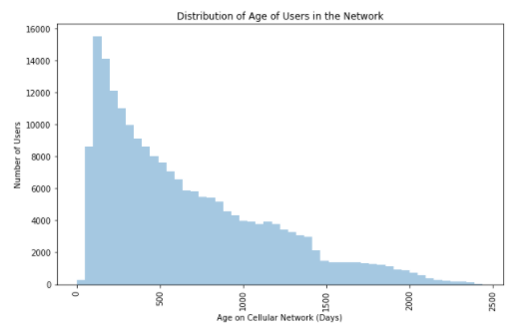
Data Analysis & Visualization
3. Aon (Age on Cellular Network (Days)):
most of the users are relatively new to the network and very few users have stayed with the network for a long time

Slide 9
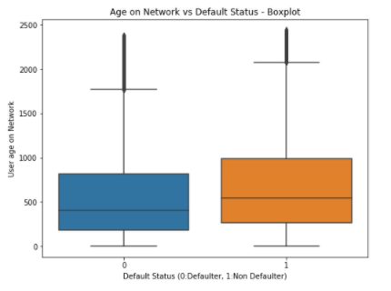
Let’s look at the box plot of age on network as per loan default status:
defaulters have relatively lower median age on the network, this implies that long time users are generally more credible

Slide 10
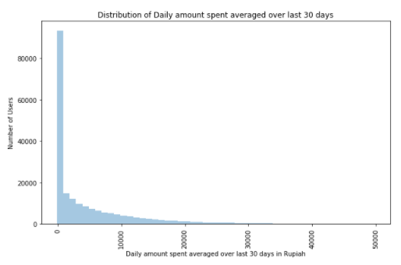
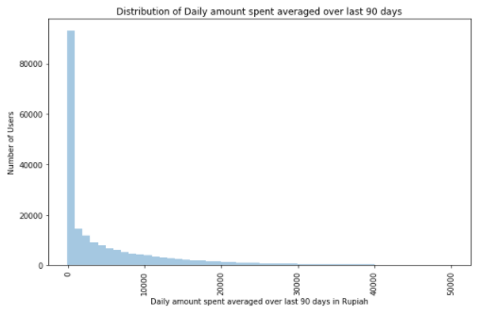
4. daily_decr30 (daily amount spent averaged over last 30 days) and
5. daily_decr90 (daily amount spent averaged over last 90 days):
These plots show that majority of the users spent lesser amounts or very few users spent very higher amounts

Slide 11
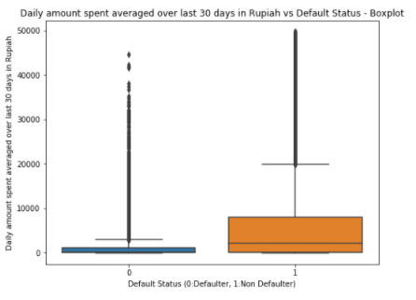
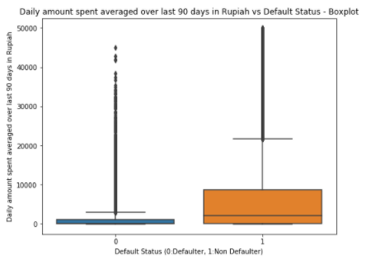
Average daily amount spent averaged over last 30/90 days as per loan default status:
the users who defaulted have relatively lower Daily amount spent averaged over last 30 or 90 days, this means that people with higher average Daily amount spent are generally more credible.

Slide 12
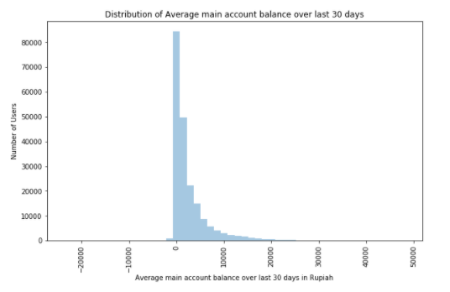
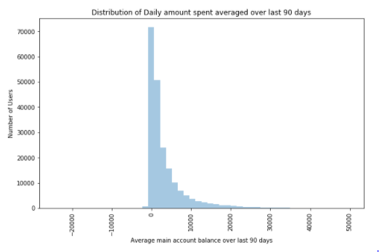
6. rental30 (Average main account balance over last 30 days) and
7. rental90 (Average main account balance over last 90 days):
Most of the users have low Average main account balance or very few users have higher balance

Slide 13
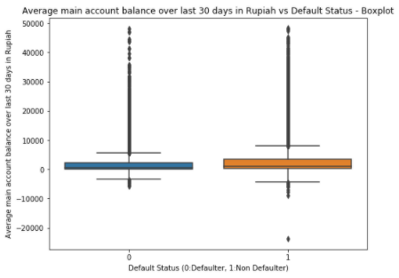
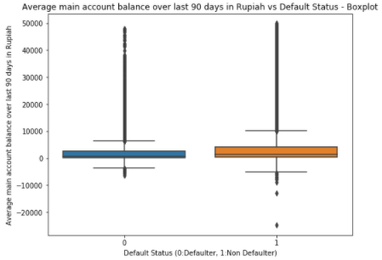
Average main account balance over last 30/90 days as per default status:
Average main account balance over last 30/90 days is relatively lower for the defaulters, this implies that people with higher average main account balance are generally more credible

Slide 14
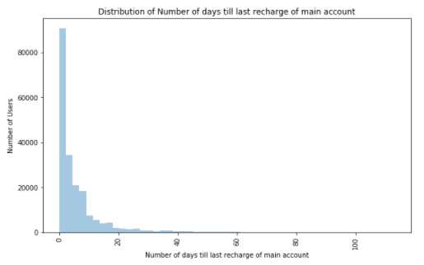
8. last_rech_date_ma (Number of days till last recharge of main account)
plot shows that most of the users recharge frequently and very few users recharge after long periods

Slide 15
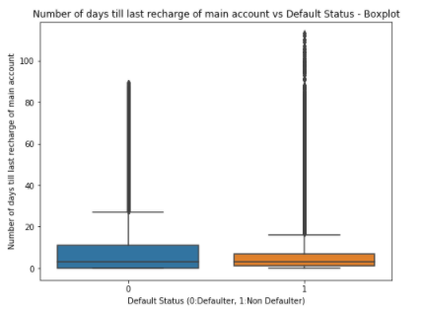
Number of days till last recharge of main account as per default status
The defaulters have relatively higher periods without recharge, this implies that people who recharge frequently are generally more credible.

Slide 16
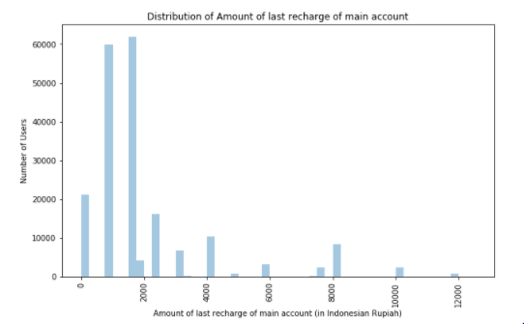
10. last_rech_amt_ma (Amount of last recharge of main account (in Indonesian Rupiah)):
Most of the users have relatively lower amounts of last recharge of main account.

Slide 17
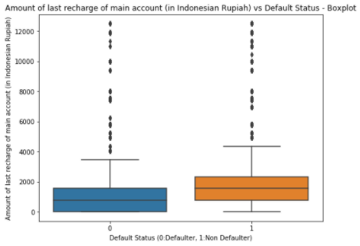
Amount of last recharge of main account as per default status:
The defaulters have relatively lower values for Amount of last recharge of main account, it also implies that users who recharge higher amounts are generally more credible

Slide 18
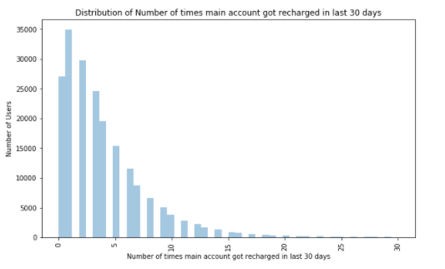
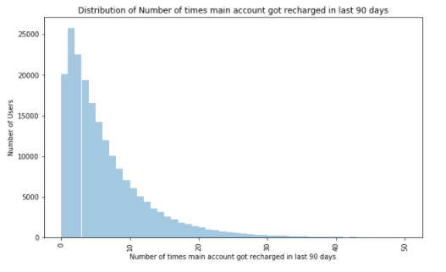
11. cnt_ma_rech30 (Number of times main account got recharged in last 30 days):
16. cnt_ma_rech90 (Number of times main account got recharged in last 90 days):
very few users recharged higher number of times over the last 30/90 days

Slide 19
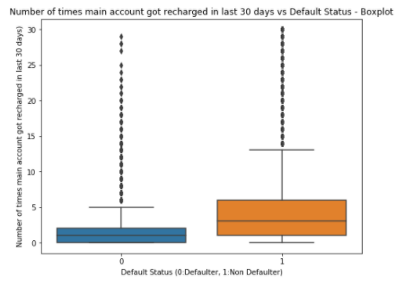
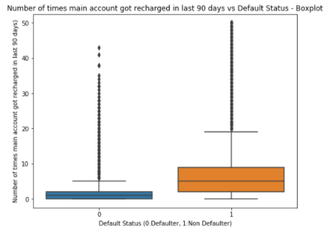
Number of times main account got recharged in last 30/90 days as per default status
defaulters have relatively very less Number of times main account got recharged in last 30/90 days this implies that people who recharge higher number of times over a period are generally more credible.

Slide 20
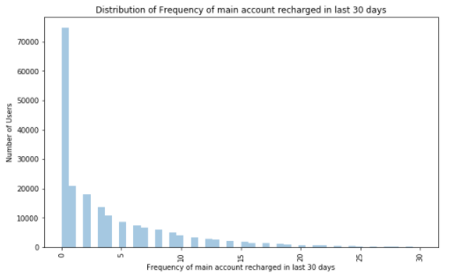
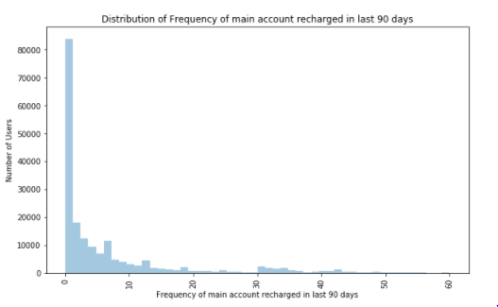
12. fr_ma_rech30 (Frequency of main account recharged in last 30 days) and
17.fr_ma_rech90 (Frequency of main account recharged in last 90 days):
Most of the users' frequency of recharge over the last 30/90 days are relatively lower

Slide 21
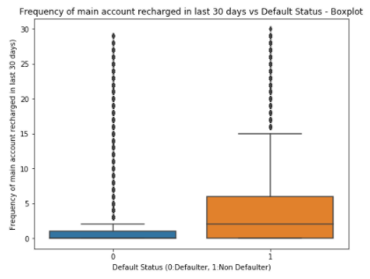
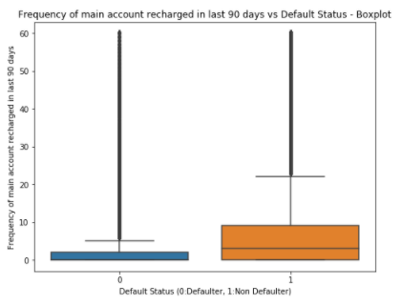
Frequency of main account recharged in last 30/90 days as per default status:
the defaulters have relatively very less Frequency of main account recharged in last 90 days this implies that people who recharge very frequently over a period are generally more credible.

Slide 22
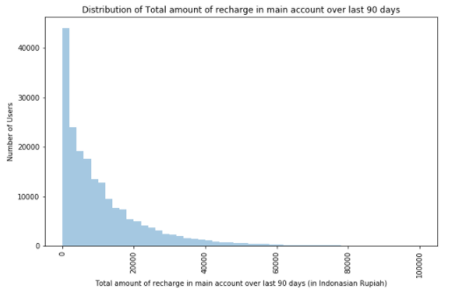
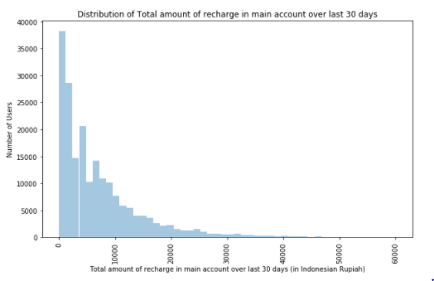
13.sumamnt_ma_rech30 (Total amount of recharge in main account over last 30 days (in Indonesian Rupiah)):
18.sumamnt_ma_rech30 (Total amount of recharge in main account over last 30 days (in Indonesian Rupiah)):
majority of the users have low values of Total amount of recharge in main account over last 30/90 days.

Slide 23
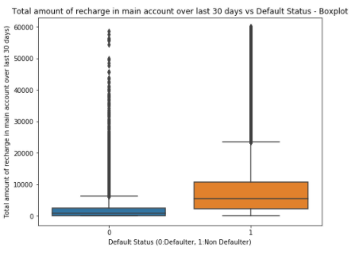
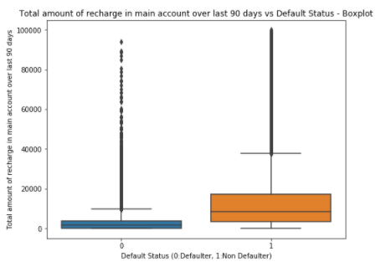
Total amount of recharge in main account over last 30 days as per default status:
Total amount of recharge in main account over last 90 days is relatively very low for the defaulters, this implies that people with higher Total amount of recharge in main account over a period are generally more credible

Slide 24
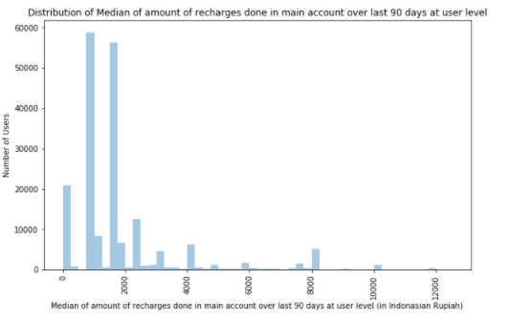
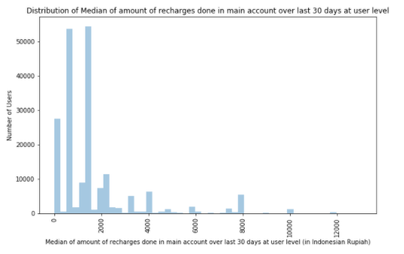
14. medianamnt_ma_rech30 (Median of amount of recharges done in main account over last 30 days) and
19. medianamnt_ma_rech90 (Median of amount of recharges done in main account over last 90 days):
Median of amount of recharges done in main account over last 30 days at user level has very few higher values, or majority of the median recharge amounts are low

Slide 25
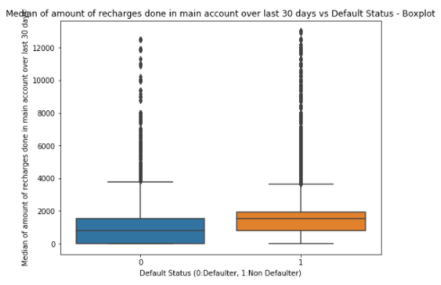

Median of amount of recharges done in main account over last 30/90 days at user level as per default status:
Median of amount of recharges done in main account over last 30/90 days is relatively lower for the defaulters, this implies that people with higher Median of amount of recharges are generally more credible.

Slide 26
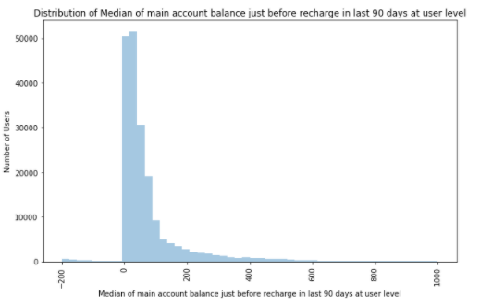
20. medianmarechprebal90 (Median of main account balance just before recharge in last 90 days):
majority of the users have low values for Median of main account balance just before recharge in last 90 days at user level

Slide 27
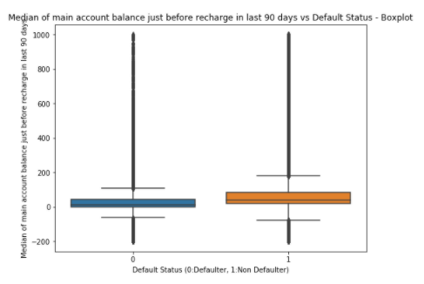
Median of main account balance just before recharge in last 90 days at user level as per default status
Median of main account balance just before recharge in last 90 days is relatively lower for the defaulters, this implies that people with higher Median of main account balance just before recharge are generally more credible.

Slide 28
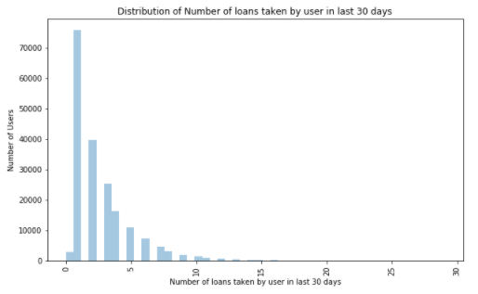
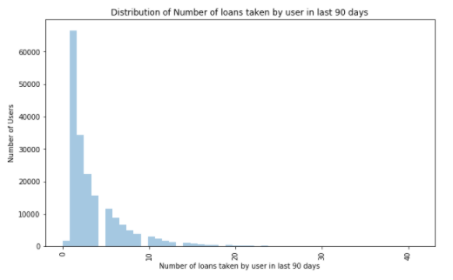
25. cnt_loans30 (Number of loans taken by user in last 30 days) &
29. cnt_loans90 (Number of loans taken by user in last 90 days):
Most of the users have lower Number of loans taken in last 30/90 days

Slide 29
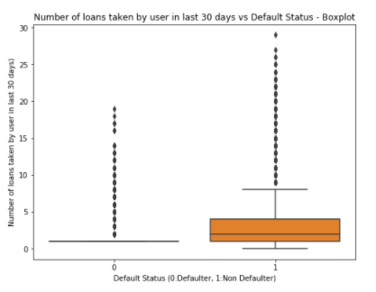
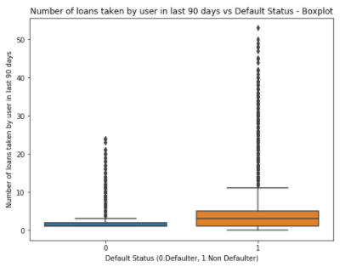
Number of loans taken by user in last 30/90 days as per default status:
defaulters have taken relatively very less number of loans over the last 30/90 days, this also implies that people who take higher number of loans are generally more credible.

Slide 30
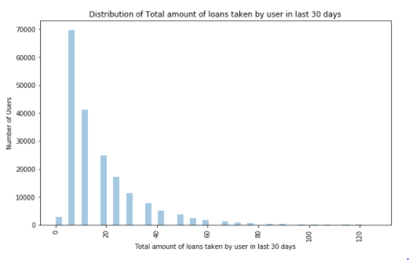
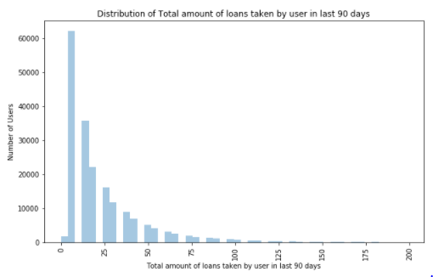
26.amnt_loans30 (Total amount of loans taken by user in last 30 days) &
30.amnt_loans90 (Total amount of loans taken by user in last 90 days):
From the above plot, majority of the users took lower Total amount of loans over the last 30/90 days.

Slide 31
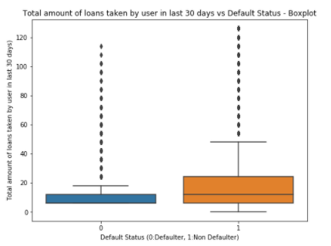
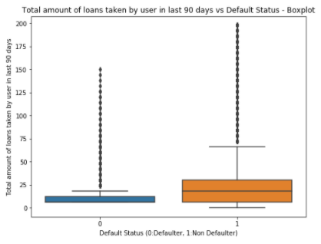
Total amount of loans taken by user in last 30/90 days as per default status
Total amount of loans taken by user in last 90 days is relatively lower for the defaulters, this implies that people with higher Total amount of loans over 30/90 days are generally more credible

Slide 32
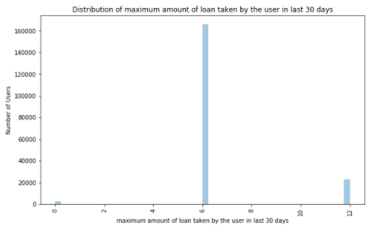
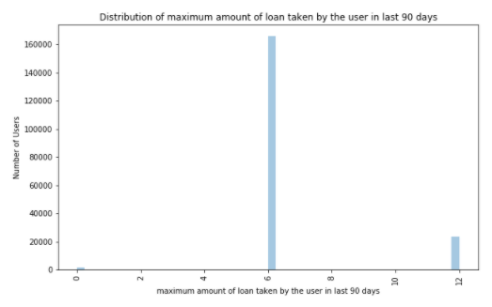
27. maxamnt_loans30 (maximum amount of loan taken by the user in last 30 days) &
31. maxamnt_loans90 (maximum amount of loan taken by the user in last 90 days):
Loans of values 6 & 12 Indonesian Rupiah were granted to users, also most users took loans of value 6 Rupiah

Slide 33
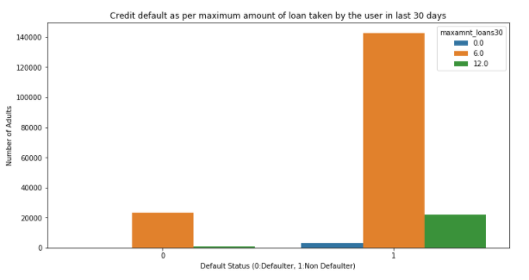
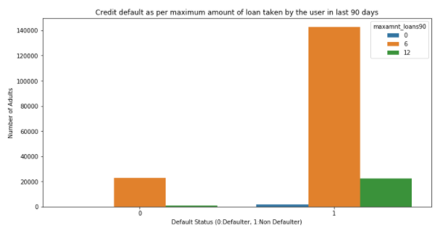
maximum amount of loan taken by the user in last 30/90 days as per default status:
6 Rupiah loans were most commonly defaulted

Slide 34
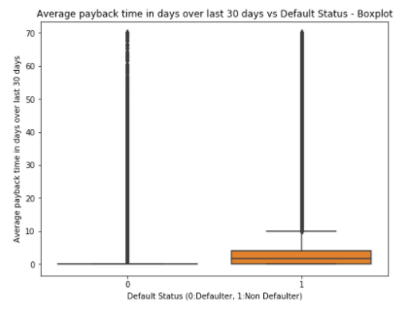
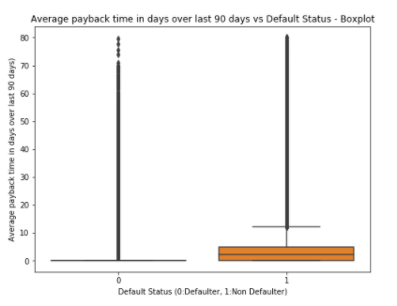
33. payback30 (Average payback time in days over last 30 days) &
34.payback90 (Average payback time in days over last 90 days):
Majority of the users have very less payback time or very few users have higher payback time

Slide 35
Model Development & Evaluation
Also after cleaning all the features, the input set of features are standard scaled for modelling
Algorithms tested for classification of defaulters
LogisticRegression
GaussianNB
RandomForestClassifier
AdaBoostClassifier
GradientBoostingClassifier
XGBClassifier

Slide 36
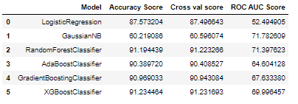
Summary of Results:
It might appear from the accuracy and cross validation scores that Ensemble methods are performing better but if we look at the confusion matrix and recall scores, we observe that these models are not good at classifying the defaulters,
Let’s look at all the models along with different evaluation metrics

Slide 37
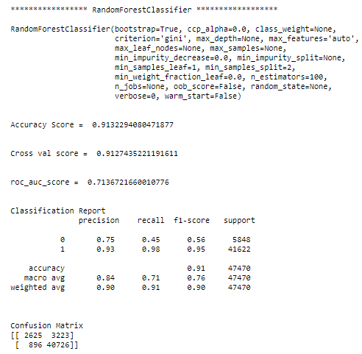
RandomForestClassifier
The model has high accuracy & cross validation score but the recall score of defaulters is worse, which means it fails to classify all the defaulters, as confirmed by the confusion metrics

Slide 38
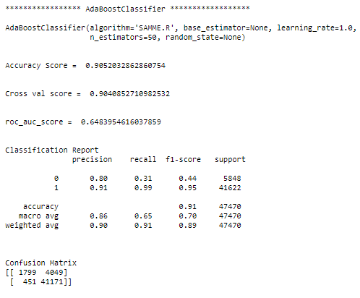
AdaBoostClassifier
The model has high accuracy & cross validation score but the recall score of defaulters is worse, which means it fails to classify all the defaulters , as confirmed by the confusion metrics

Slide 39
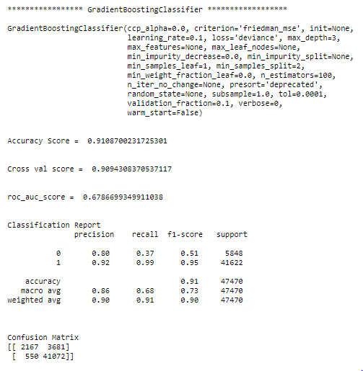
GradientBoostingClassifier
The model has high accuracy & cross validation score but the recall score of defaulters is worse, which means it fails to classify all the defaulters , as confirmed by the confusion metrics

Slide 40
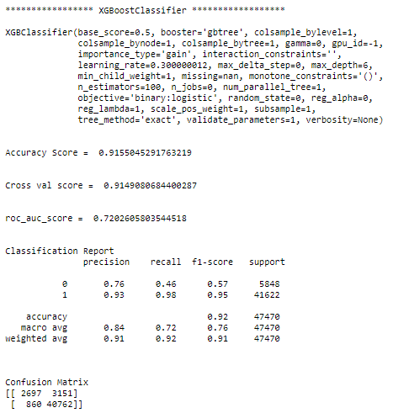
XGBoostClassifier
The model has high accuracy & cross validation score but the recall score of defaulters is worse, which means it fails to classify all the defaulters , as confirmed by the confusion metrics

Slide 41
Key Evaluation Metric:
The key metrics used in solving the problem were recall and confusion matrix as we are interested in classifying all the defaulters correctly in this specific business application.

Slide 42
Interpretation of Evaluation Metrics
While ensemble methods are providing accuracy & cross validation scores as high as 91% their recall scores are very low. The best recall score obtained is 88% by using the GaussianNB Classifier which means it classified 88% of the total defaulters correctly, it also has the highest precision score of 97% out of all the models for classifying non-defaulters which means out of all the classified non-defaulters 97% were correctly classified. But such high recall score for defaulters and high precision score for non-defaulters comes with a lot of non-defaulters being classified as defaulters which is why the accuracy and cross validation scores are lower for the GaussianNB Model. The fact that the dataset is highly skewed (only 12.5% of defaulters), also contributes to the low accuracy score.

Slide 43

GaussianNB Classifier

Slide 44

Let’s perform GridSearchCV for the best model identified:

Slide 45
Conclusion of the Project
From the data analysis we found that the following types of users are generally more likely to default:
Short-time users
Users with lesser average daily amount spent
Users with lesser average main account balance
Users who recharge less frequently or lesser number of times over 30/90 days
Users who recharge lesser amounts
Users who recharge lower total amounts over 30/90 days
Users with lower median of amount of recharges over 30/90 days
Users with lower median of main account balance just before recharge
Users who take loans less frequently or lower number of loans taken over 30/90 days
Users who take lower total amounts as loans over 30/90 days
Also 6 Rupiah loans were defaulted more frequently when compared to 12 Rupiah loans.

Slide 46
Conclusion of the Project continued:
Ensemble algorithms like RandomForestClassifier & GradientBoostingClassifier give almost 91% accuracy/cross validation score but their recall scores are low. The highest recall score obtained was 88% using GaussianNB algorithm, also this model has the highest precision score of 97% out of all the models for classifying non-defaulters classifier Which means that the GaussianNB classified 88% of the total defaulters correctly, also out of all the classified non-defaulters 97% were correctly classified. But the model also wrongly classifies many non-defaulters as defaulters which is why we get lower accuracy and cross validation scores. The fact that the dataset is highly skewed (only 12.5% of defaulters), also contributes to the low accuracy score. So from the business perspective it allows us to safeguard against defaulters as well as an improved selection of customers for loans. But this safeguard comes at a cost of classifying many non-defaulters as defaulters. But if there’s a considerable fraction of defaulter in the dataset or the dataset is less imbalanced than no model performs better than GaussianNB model in selecting customers correctly (high precision score) and in rejecting all potential defaulters (high recall score).

Slide 47
Thank You

